Slide 1

Analysis of VC Funding
Shouham B Banerjee
21CH10062
Mentor:- Prof. Prabha Bhola (RMSoEE)

Slide 2







Venture Capital
Venture capital (VC) is a form of private equity financing provided by investors to startups and early-stage companies that have high growth potential but also involve significant risk. It is typically used to fund innovative or emerging businesses that lack access to traditional sources of capital like bank loans due to limited operating history or lack of tangible assets.
Key Characteristics of Venture Capital
High-Risk, High-Reward:
VC investments are inherently risky, as startups often operate in unproven markets or with untested products.
However, successful investments can yield substantial returns.
Equity-Based Financing:
Venture capitalists usually provide funding in exchange for an equity stake in the company, giving them partial ownership.
Active Involvement:
Beyond funding, VCs often provide strategic guidance, mentorship, and access to their network to help the business grow.
Stages of Investment:
VC funding typically occurs in multiple stages, aligning with the growth of the company (e.g., seed funding, Series A, B, C, etc.).
Exit-Oriented:
Venture capitalists aim to exit their investments through events like Initial Public Offerings (IPOs) or acquisitions, where they can realize significant returns.

Slide 3


Significance of the project
Indian startup ecosystem faced challenges in 2023 with funding winter intensifying, leading to venture closures. Deal volume and size declined, mega rounds dropped by 70%, and unicorns decreased. Tech startups saw a decline while focus shifted to traditional sectors.
In terms of deal flow shifts, the number of mega rounds plummeted by almost 70%, from 48 to 15 over 2022–23. Also, the emergence of unicorns experienced substantial declines reaching pre-2019 levels
Over 20,000 employees were sacked by leading startups with edtech contributing the largest share.
In India, Tech Startups witnessed a significant decline in 2023 as the deal flow to consumer tech, fintech, software, and SaaS decreased from $18 billion to $5.6 billion over 2022-23.
There is also a decline in high-value fundraisers, that is, $200 million decreased from 10 to 4 over 2022-23, while the largest fundraiser in 2023 was $700 million (Nexus Venture Fund VII) as compared to $2 billion in 2022.
Karnataka Tech startup ecosystem saw a total funding of $3.4 billion in 2023, which is a 72% plunge from the $12.2 billion raised in 2022.
The deal volume compressed by approximately 45%, falling from 1,611 deals to 880 over 2022–23; average deal value decreased by about 30%, from $16 million to $11 million over 2022–23, while the share of seed deals rising from approximately 60% to 70% during the same period.
Our Analysis comprises data of over 350 Startups which have successfully raised funding in the last 1-1.5 Yrs. The Objective of this analysis is to understand Venture capital outlook and provide perspective into what the future of Indian Entrepreneurship beholds.

Slide 4
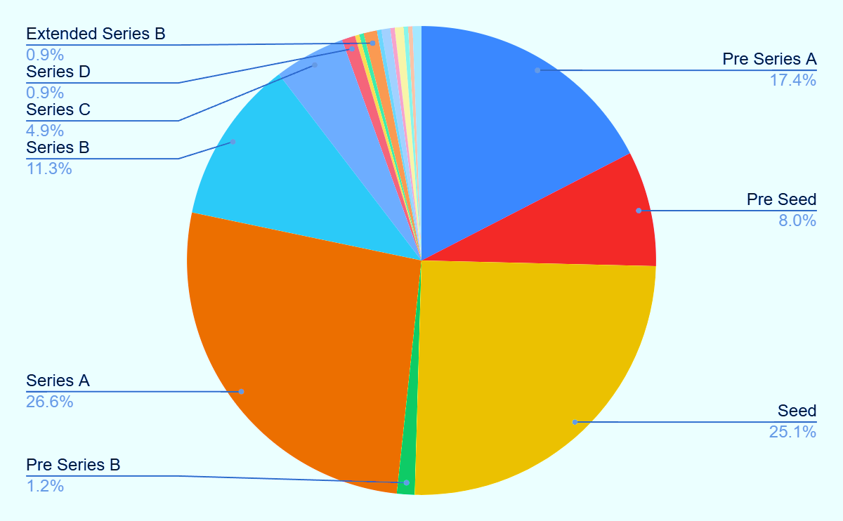
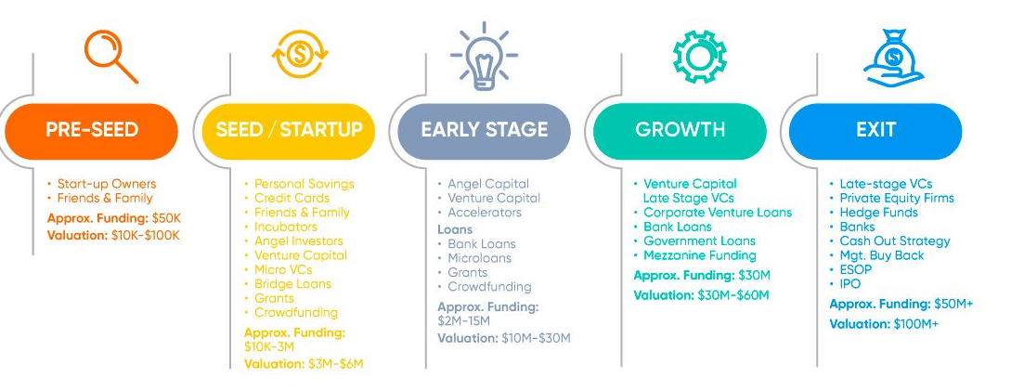
Distribution by Funding Round
We try to analyze the distribution of the entire funding received in Round Basis:-
The Pre-Seed, Seed, Pre-Series A and Series A combined share an impressive 77% of Total Funding Achieved. This Denotes a Significant Shift in Investor Risk Aversion.
The Largest Share of Series-A Still Hints at Investor Inclination towards startups which already have stable revenues and robust Market Share.
The Relatively Negligible Share of Later Funding Stages (Series C, D) signify the increased focus on Profitability for Later Stage Mature Startups.
The average funding value in seed round is around $ 2 Million ranging from $125 Thousand to $ 20 Million.
Pre-Seed Funding has seen substantial growth, average funding value as $ 0.8 Million.
The Lower share of Funding in the later stages can also be attributed to the deal size of later stage funding. The average Series C funding lies in the $25 Million range contributing to increased Concentration Risk and Reduced Diversification in the VC’s Portfolio.

Slide 5
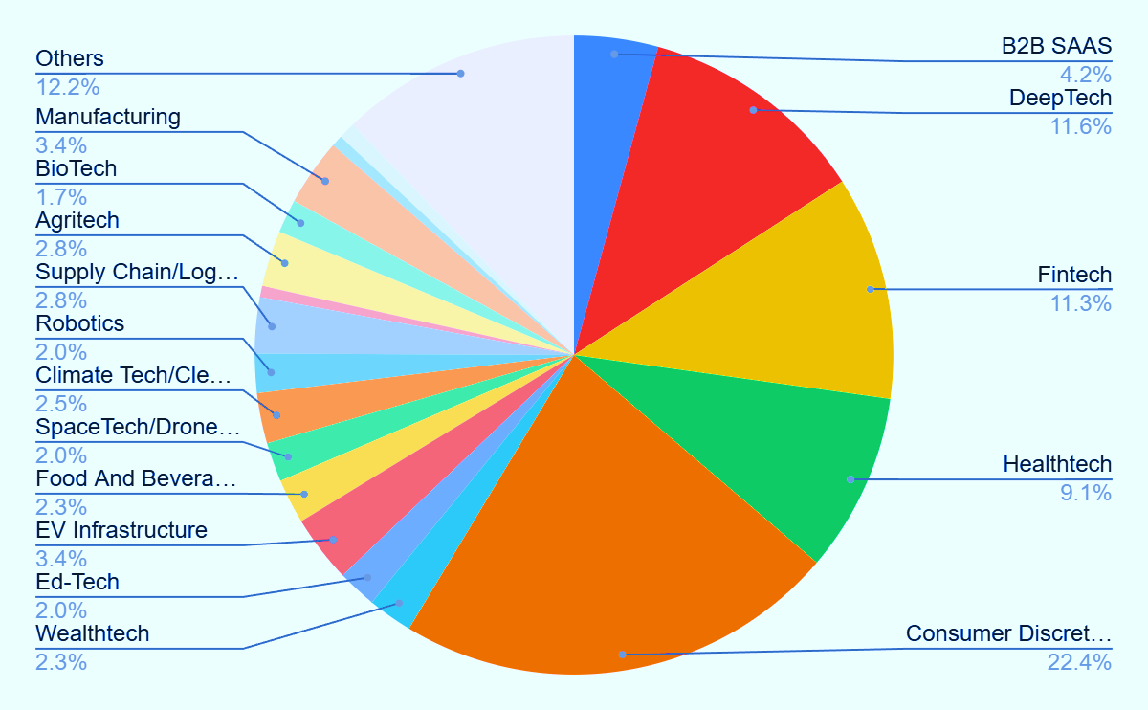


Sector Analysis of Venture Capital Funding
Investor confidence was observed in DeepTech, Fintech and Consumer Discretionary Startups. HealthTech has witness substantial growth post the pandemic.
Deep-Tech Startups working on Generative AI, Large Language Models (LLM’S) are a New Investor Favourite with large amounts of Inflows from Prominent VC’s.
Direct to Consumer Brands have the largest share of Investor Funding. Consumer Discretionary have become an Investor Favorite with Brands like Snitch, Bewakoof, The Souled Store becoming multi million dollar companies
Approximately 80% of generative AI application funding was attracted by existing companies integrating generative AI in their extant workflows, in comparison with 20% funding to such native startups.
A new Emerging Sector is seen among the Wealth Management Space with Wealth-Tech Startups like DEZERV, Stable Money, Centricity, InvestorAI, and Neo Wealth Management Successfully raising Funding during these difficult Times.
EV Infrastructure has gained significant momentum attracting over 3% of total funding. This sector has huge potential of future growth aligning itself with the Nation’s Vision of achieving net zero by 2070.
An Emergence of the Manufacturing Sector is seen as an impetus to the Make-In- India Initiative of the Central Leadership, Attracting 3.4 % of Total Funding.
Ed-Tech Startups have struggled to regain Investor confidence due to extremely saturated Market and high competition. Consequently it has only attracted 2% of total funding.

Slide 6
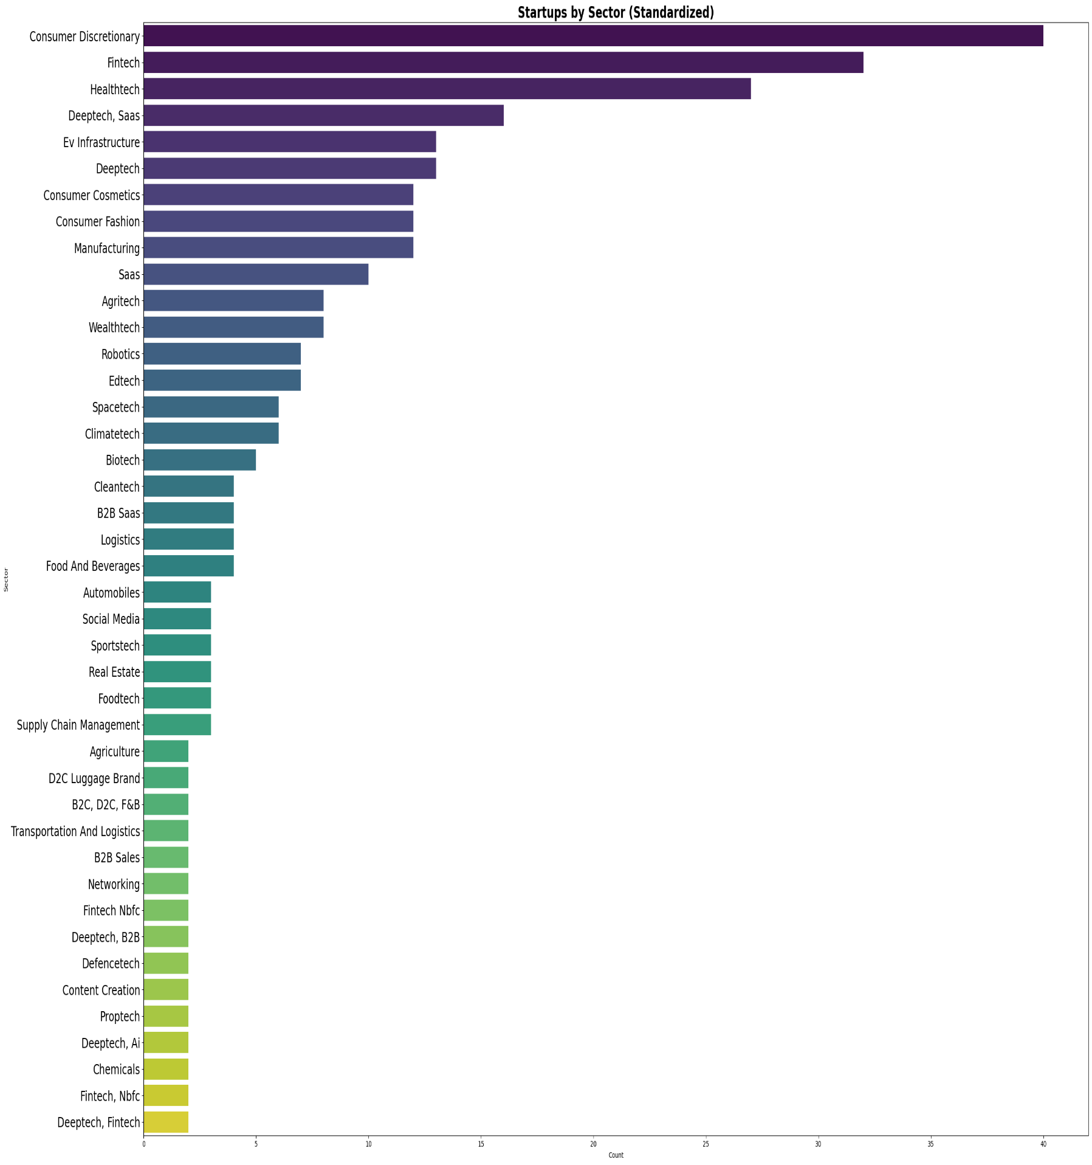

Slide 7
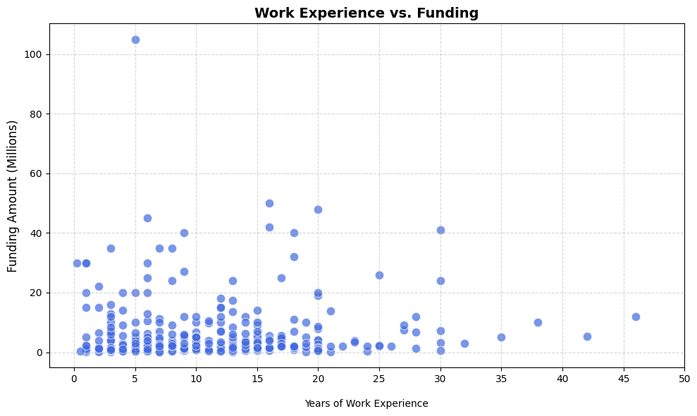
A Scatter Plot showing the relation between the Funding Amount and the Work Experience of the Founder. We Obtain a few Interesting Insights through this graph.
This confirms the belief that Moderate to high work experience (5–15 years) generally increases the probability of funding, especially from institutional investors like VCs and PE funds.
Very high work experience (20+ years) may correlate with lower startup activity or less risk-taking behavior, especially in younger ecosystems.
Founders with previous startups (even failed ones) are seen as more fundable. Some investors favour younger founders (<35) for scalability, energy, longer time horizon. Early-stage (idea/pre-seed) may favor young & bold; growth-stage favors experienced operators.
A correlation of Relevant Work Experience is also observed within the startup Landscape. This confirms the belief of mandatory industry knowledge and networking benefits while building successful ventures.
Fig 3. Years of Work Experience(X-Axis) and Funding Amount (Y-Axis)

Slide 8
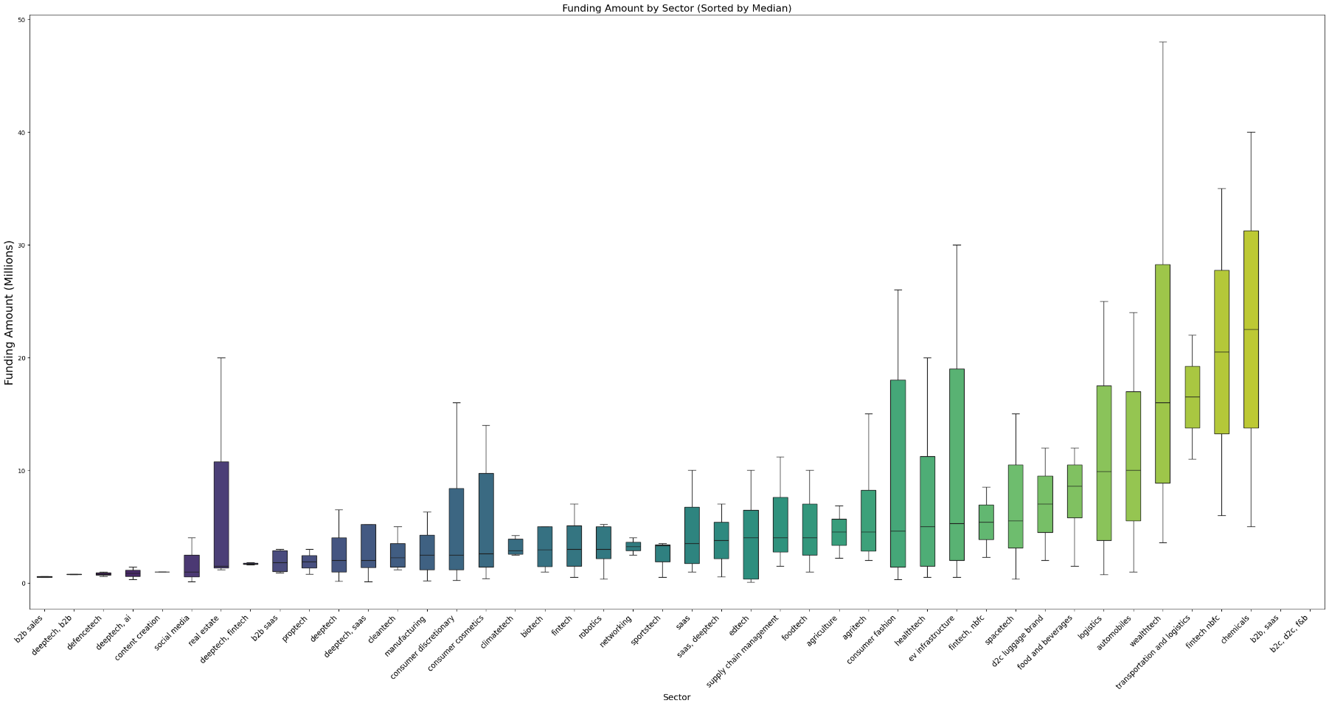
This is one of the most interesting graphs. Our Earlier analysis involved comparing the numbers of Startups in a particular sector but here we also do a side by side comparison with the total amount of Funding Raised.
The Biggest Candle belong to the WealthTech Sector with Median Funding north of $15 Million. A high close to $50 Million is also observed. The Wealth Management Space with Wealth-Tech Startups like DEZERV, Stable Money, Centricity, InvestorAI, and Neo Wealth Management looks poised for future growth driven by a expanding middle class and robust growth in capital markets.
The Fintech (NBFC) space has shown substantial resilience raising a median funding of 20 $Million. The Sector itself has a projected CAGR of 18-20%, with Tech Enabed NBFC’s using embedded finance driving future growth.
The Chemical space has also attracted substantial funding with median funding close to $20 Million. Indian chemical manufacturing sector is a $220+ billion industry and Startups like Scimplify are disrupting this market with their Innovation.
EV Infrastructure Space has shown resilient funding due to government support inline with the vision of being India Being Carbon Neutral by 2070, with median Funding of $5 Million and the upper Quartile of $20 Million.

Slide 9
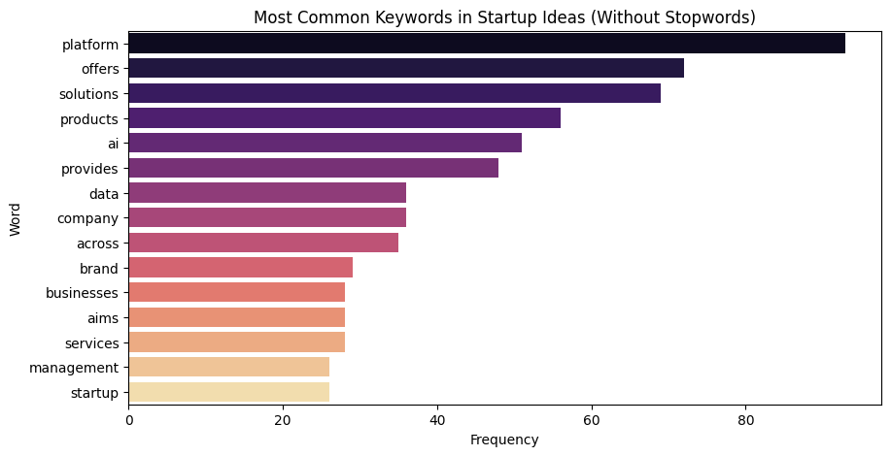
Text vectorization is the process of converting textual data (words, phrases, or sentences) into numerical representations (vectors) that can be understood and processed by machine learning models. Bag of Words turns sentences into fixed-length vectors where each dimension corresponds to a unique word in the corpus, and values represent the frequency of that word.
Text Vectorization is executed on the dataset of the ideation column and then the frequency of word occurrences is plotted. Machine learning algorithms work with numbers, not words. Text vectorization bridges this gap by transforming raw text into structured numeric formats.
The Interesting insights are as follows: -
The first 4 Words are general services-oriented words like “Platform”, “Offers”, “Solutions” and “Products”.
The Occurrence of AI as the fifth most used word enables to understand the scale of Artificial intelligence integration taking place in the Indian Startup Landscape. Almost every sector is adopting Artificial Intelligence to streamline daily operations.
Data is the 6th most used word suggesting heavy influence of data science and development of Big Data Management tools in the Indian Startup Landscape.
Fig 4. Frequency of Occurrence(X-Axis) and Word(Y-Axis)

Slide 10
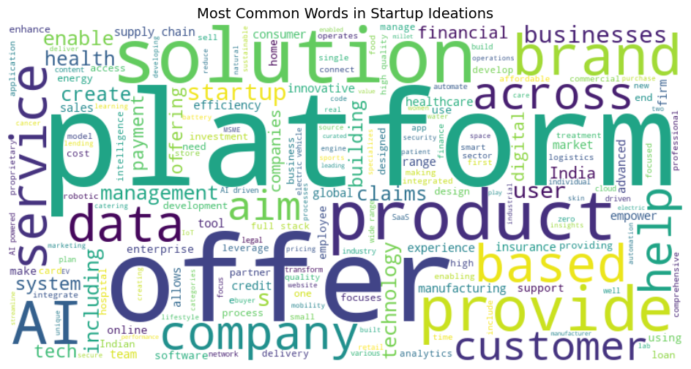

Slide 11
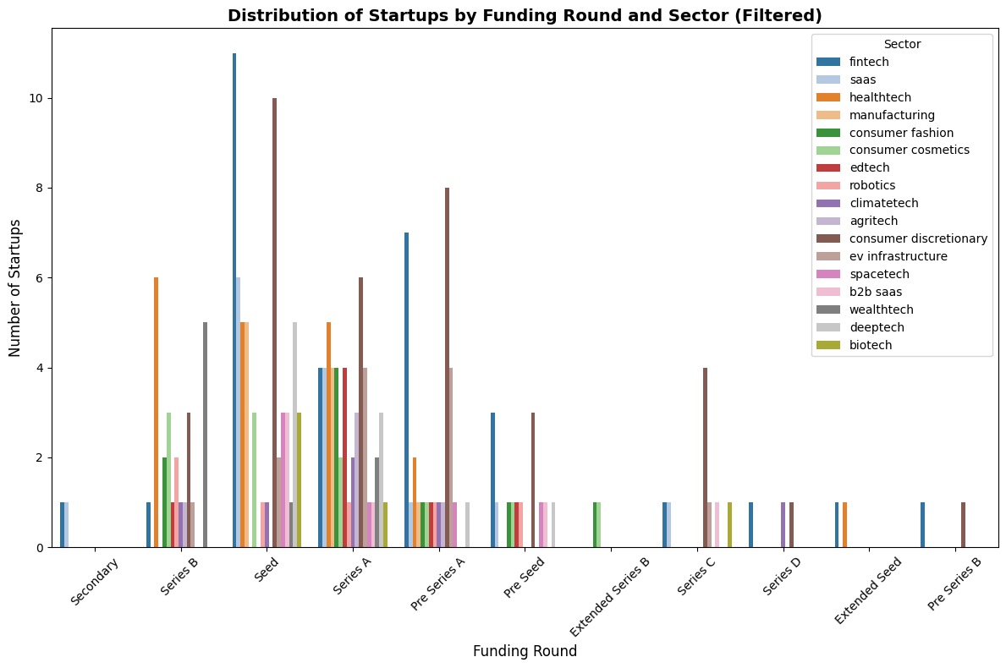
In this Plot we have a multivariable analysis involving the sector and the Funding Round of the Startup.
Fintech Continues to lead the Indian Startup Movement with highest concentration in the Seed Funding Round.
Consumer Discretionary is a very well distributed sector with Seed, Series A and Pre-Series A. D2C Brands are on a meteoric Rise with stories like Snitch, The Souled Store and Bewakoof fueling investor sentiment. Consumer Discretionary is a very well distributed sector with Seed, Series A and Pre-Series A. D2C Brands are on a meteoric Rise with stories like Snitch, The Souled Store and Bewakoof fueling investor sentiment.
DeepTech Startups have significantly more concentration in the Seed phase, as seen in the plot. This suggests Heavy capital Investment in a Sector which is very R&D focused and is in the nascent Stage Currently.
HealthTech is a more Diversified Investment, finding Significant share in Seed, Series A and Even Series B Rounds. This Suggests that HealthTech as a sector is maturing and is poised for growth stabilisation in the future.
Fig 5. Funding Round(X-Axis), Sector(Bars) and Frequency of Occurrence (Y-Axis)

Slide 12


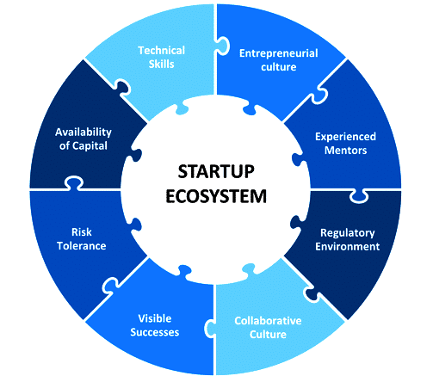


Conclusions
The project was aimed at a quantitative analysis and understanding of the current funding landscape and the possible reasons for securing capital in a high interest rate environment, wherein the era of easy money is gone.
Venture capitalists have pivoted towards Innovation and Experimentation supporting a large number of startups early on through Pre-seed and Seed Funding Rounds, contributing to 33% of total Funding.
A Rising Middle Class has resulted in more Disposable Income contributing to a greater market for Wealth Management Services leading to the emergence of Wealth-Tech Startups attracting significant funding. Deep-Tech Startups working on Generative AI and Large Language Models (LLM’s) have become an Investor Favourite.
Work Experience has proven an inevitable trait for successful entrepreneurship. Moderate to high work experience (5–15 years) generally increases the probability of funding, especially from institutional investors like VCs and PE funds.
Text vectorization yields the insight that Integration of Artificial Intelligence is happening at an unprecedented scale. Startups not operating in DeepTech Sector are also adopting Artifiicial Intelligence to streamline operations, Improve Customer Experience and Boost employee Productivity.
A Geographic Correlation has emerged with the sector of the strartup. Bangalore has emergered as Balanced Location for both Fintech and Conusmer Discretionary whereas Gurugram has emerged as a Fintech Favorite and Mumbai Taking the place for the Consumer Discretionary sector.

Slide 13
Thank you for your attention

